Slide 1

CODE REFACTORING AND BUG FIXING REPORT
ON
NOTE TAKING APPLICATION

Slide 2
About me
Prajwal Krushnat Gharal
I have completed my Bachleor of Science in 2023
I am a Fresher
I am enthusiastic about data science , especially considering how the quickly technology is changing the profession. My aim is to provide accurate information and insights to help user understand and work with data effectively .
Linkedin :https://www.linkedin.com/in/prajwalgharal/
Github :https://github.com/Prajwal75/AMCAT_Project

Slide 3
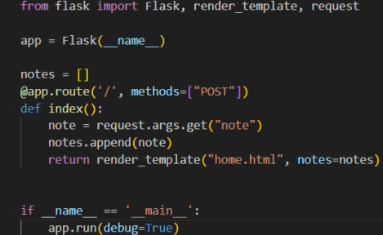
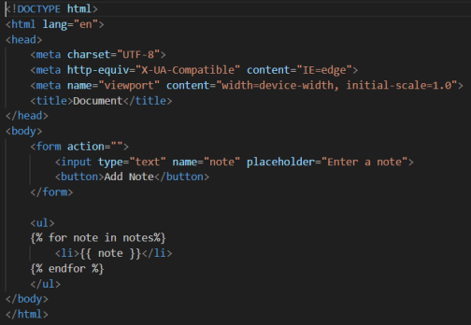
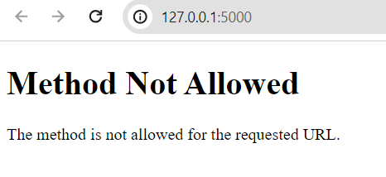
BUG FINDING ON THE APPLICATION SERVER :
CODE
OUTPUT

Slide 4
BUG DETECTION:
CODE
NOTE:
We have to use the "GET" method instead of the "POST" technique as the former isn't enabling us to render the template.

Slide 5
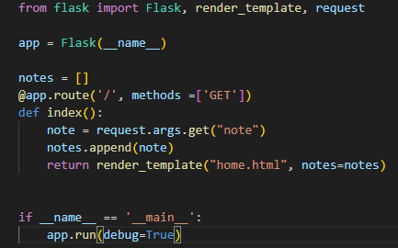
FIXING BUGS :
CODE

Slide 6
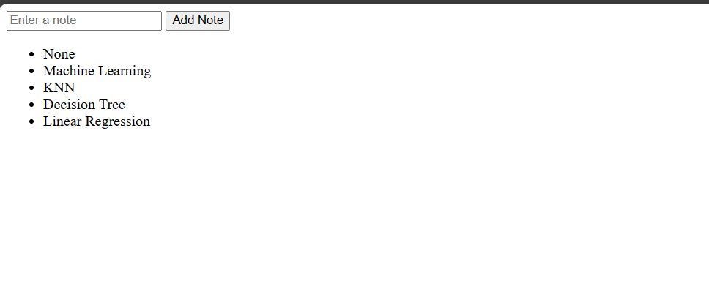
FIXING BUGS :
OUTPUT
NOTE:
Now that the bug has been addressed, it is functioning properly.

Slide 7

THANK YOU

